Slide 1
Manx National Heritage
Welcomes
BISA
Conference
2013

Slide 2
Digitising Sound Archives - A Manx Case Study
The Digitally Un-enhanced Version!
Roland Ardern-Corris - AV Technician
Paul Weatherall - Library & Archive Services Officer
Manx National Heritage

Slide 3
If you’ve got it, flaunt it!
Have you got it?
Do you have full rights to make your sound archive accessible?
Are there any restrictions?
Time constraints?
Publishing constraints?

Slide 4
Scope
8 Shelving Bays out of 6 store rooms of Library & Archive collections
About 1000 items as opposed to hundreds of thousands of documents and photos
Most formats (including a few wax cylinders)
Dating from 1920s to present

Slide 5
Oral History
Of particular interest are recordings of Manx Gaelic speakers
Also currently reminiscences of life during WW1 (for exhibition planned for 2014)

Slide 6
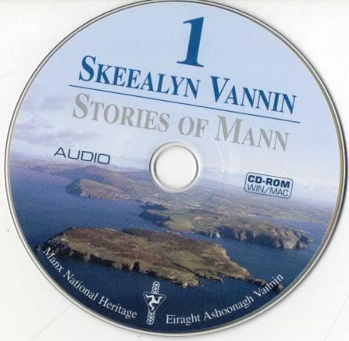
Skeealyn Vannin
Stories of Mann
The complete collection of Manx language archive recordings made by the Irish Folklore Commission in 1948
(ISBN: 0-901106-47-X)
“A unique opportunity to
hear the voices of the last
native Manx speakers
telling their stories in their
mother tongue”
Notes:
Ever since these recordings were made, it has been an aim of Manx National Heritage to make them accessible to researchers and the wider public – not least to assist in the revival and continuance of Manx Gaelic as a living language.
“Skeealyn Vannin” was published in 2003. It consists of a book complete with 6 CDs containing copies of the original recordings, digitally re-mastered by Radio Telefis Eireann, with permission of the copyright holder, University College, Dublin.
The book contains background notes on the original project, inspired by a visit to the Isle of Man by Taoiseach Eamon DeValera in 1947 , transcriptions and translations into English of the sound recordings, and an explanation of the process involved in the digital transfer from the original 78 rpm 12-inch acetate disks.
5 CDs contain the digitised recordings as cda (CD Audio track) files, together with pdf files of the transcripts and translations on the 6th CD.

Slide 7
The “Tell Me” Project
Publications
Website: http://www.thetellmeproject.com/

Slide 8
Manx Heritage Foundation
Website: http://www.manxheritage.org/cms/oral_hist_index.html

Slide 9
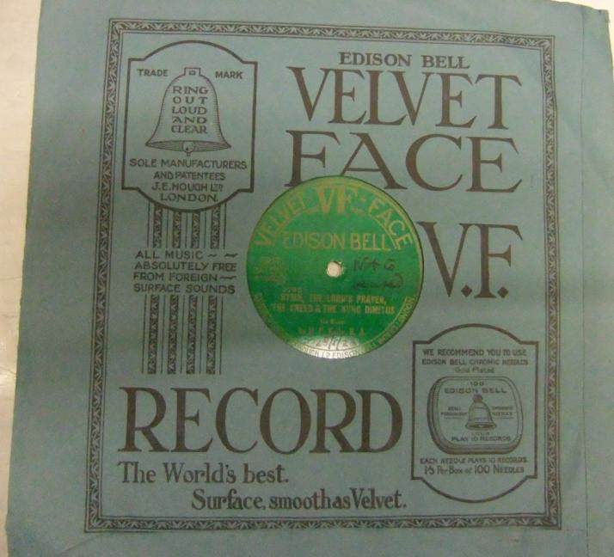
Manx Museum & National Trust
Trustees commissioned recordings in London in 1925/6 of Manx music and speech

Slide 10
iMuseum
Opened as a building in MARCH 2011
Access to MNH Archive, Library & Museum collections
Emphasis on Family History and Manx Newspapers
Includes Images of Art Collections, Photo Archive and other Museum Objects
Sample selection from the IoM Film & Sound Archives

Slide 11
Sound Archive
Selection for iMuseum
Funding from Friends of Manx National Heritage - £70,000 for film and sound
Priority given to Oral History in Manx Gaelic
Research with JISC, BISA, British Library, National Library of Scotland
Contract Specification agreed
Contract won by Tobar an Dulchais
Audio Files hosted by Vzaar
Public Access through iMuseum

Slide 12
Digitisation
Storage

Slide 13


Ned Maddrell

Slide 14
Digitisation
Storage

Slide 15
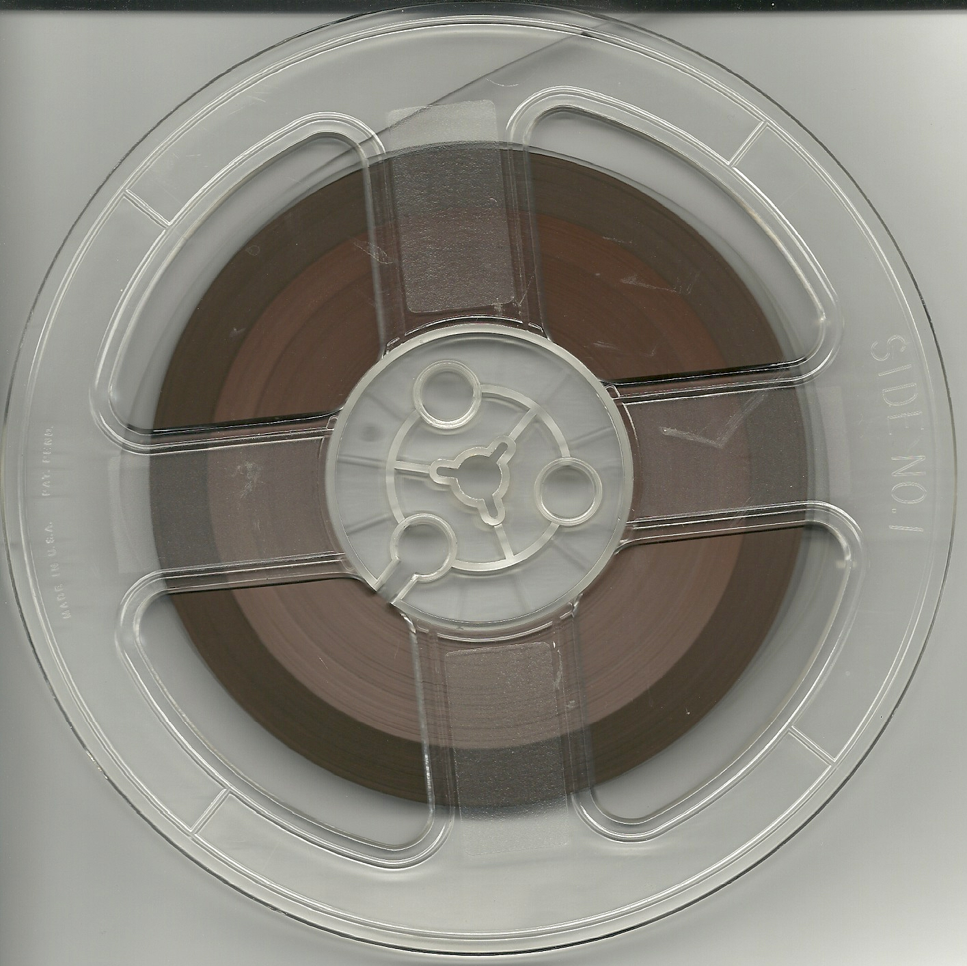

Slide 16
Standards
iasa
48-24 96-24

Slide 17
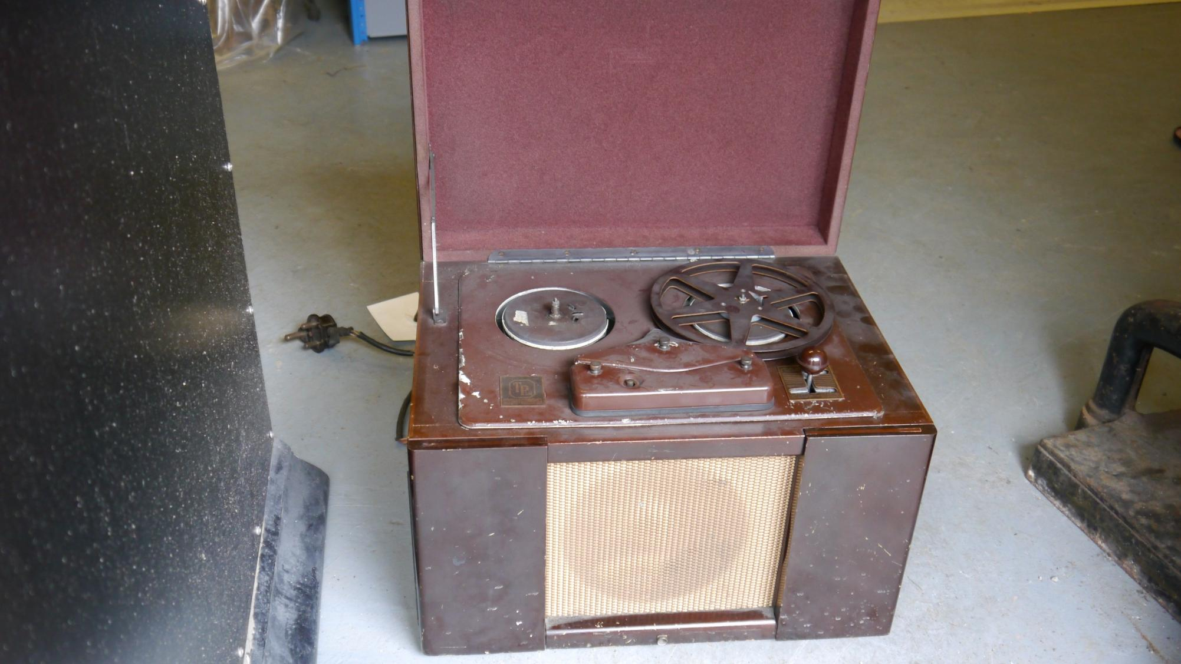

Slide 18
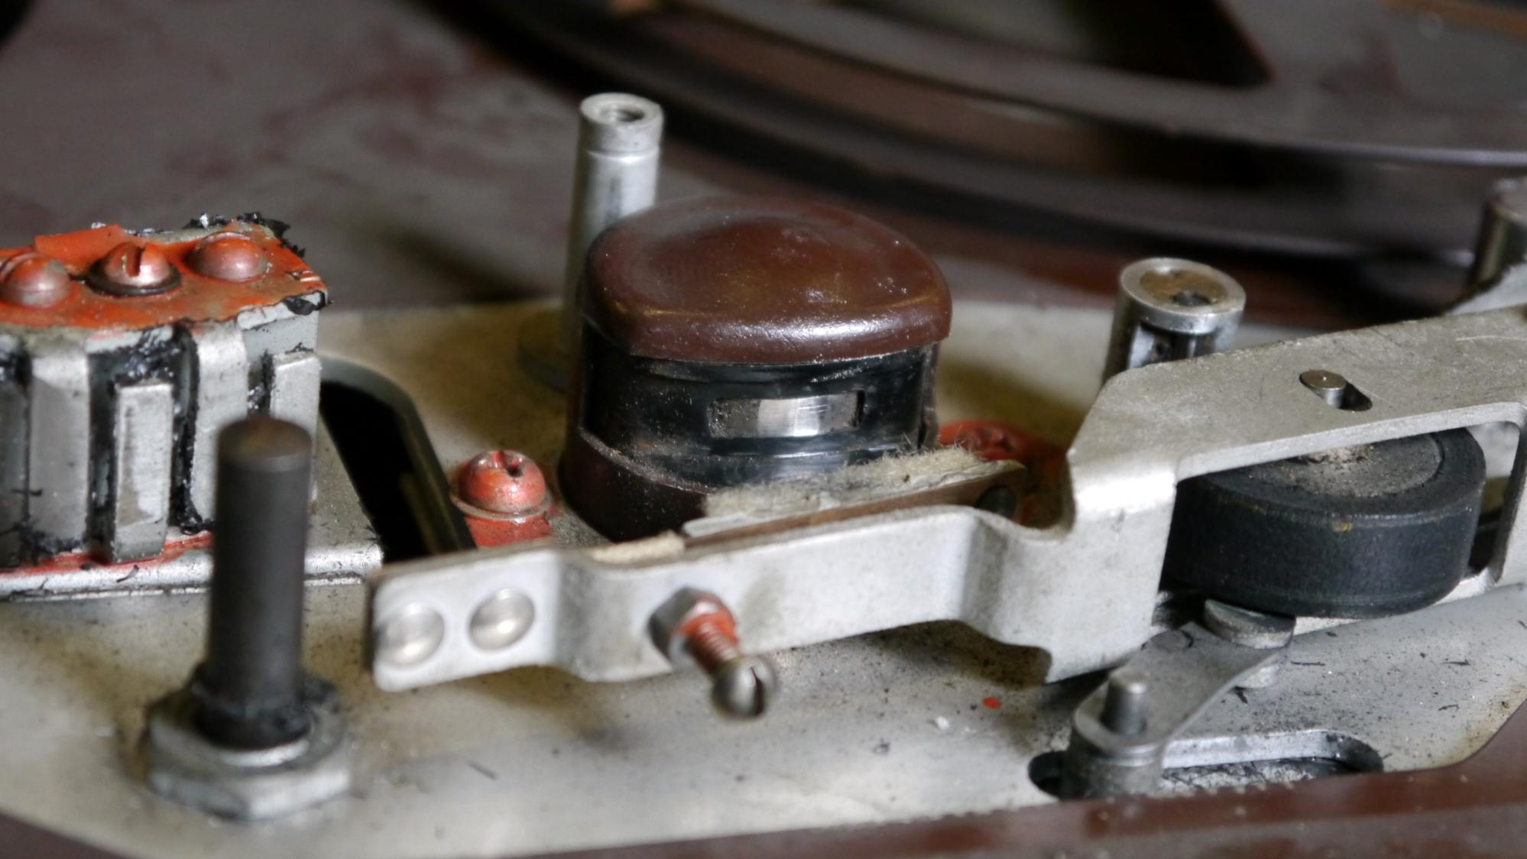

Slide 19
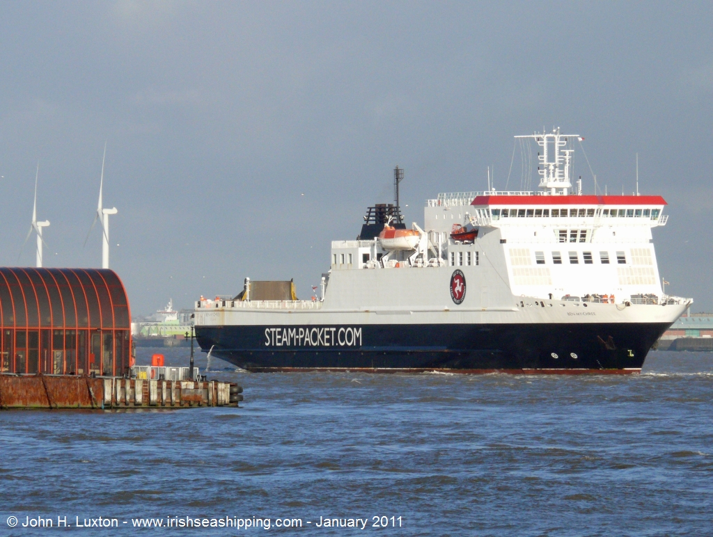

Slide 20
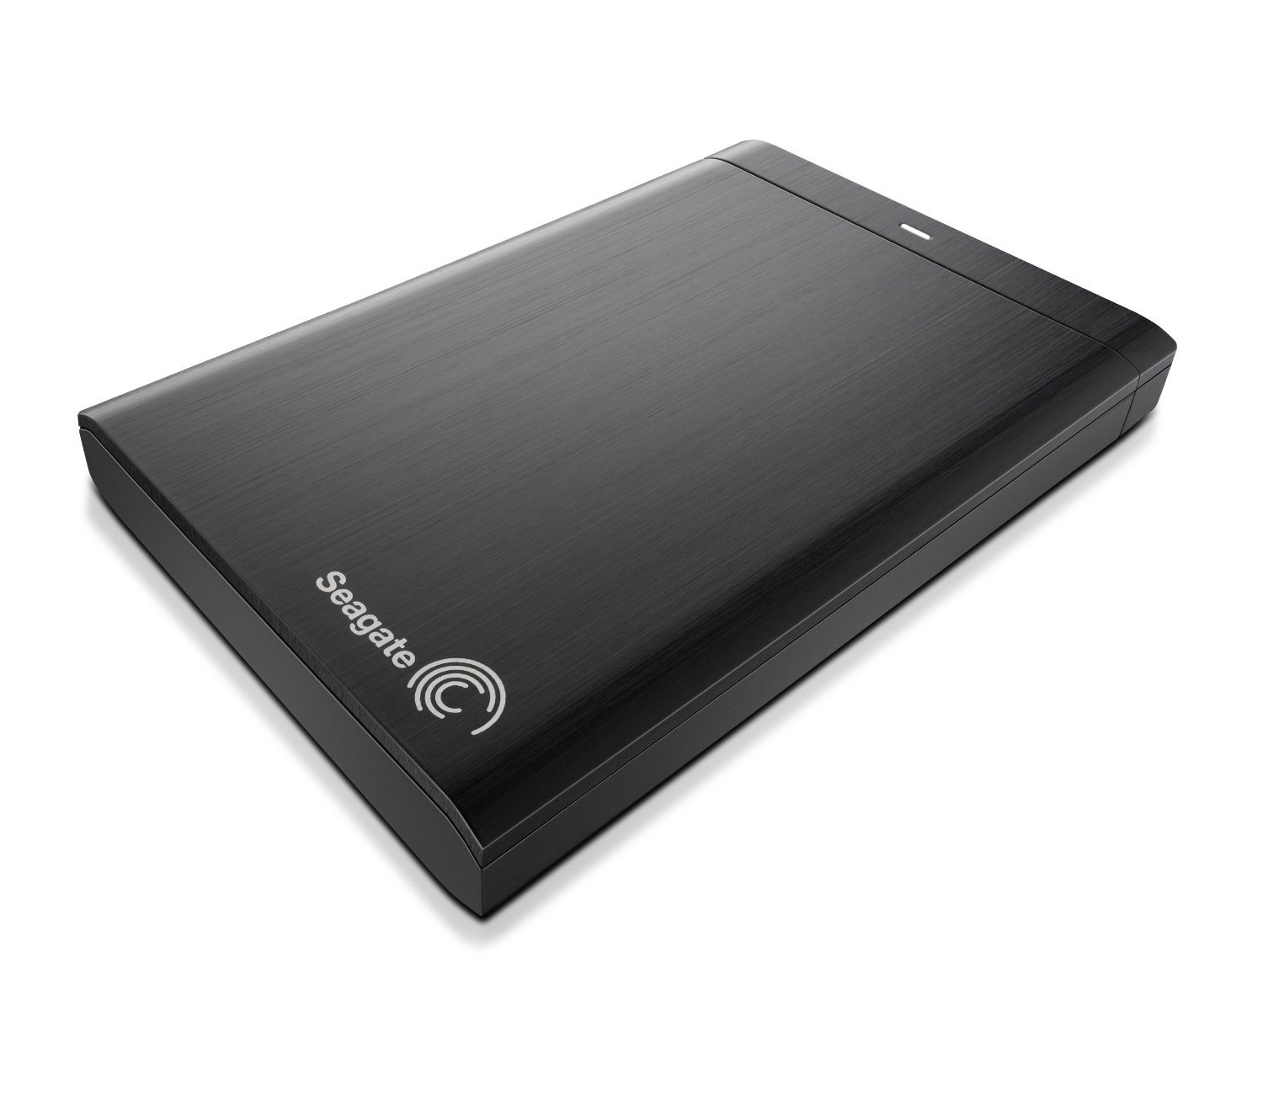

Slide 22
What happens when the files come back?

Slide 23
Risks
Media failure
Hardware failure
Obsolescence
Cyber attack
Organisational failure

Slide 24
Hard drives
or
Something else?

Slide 25
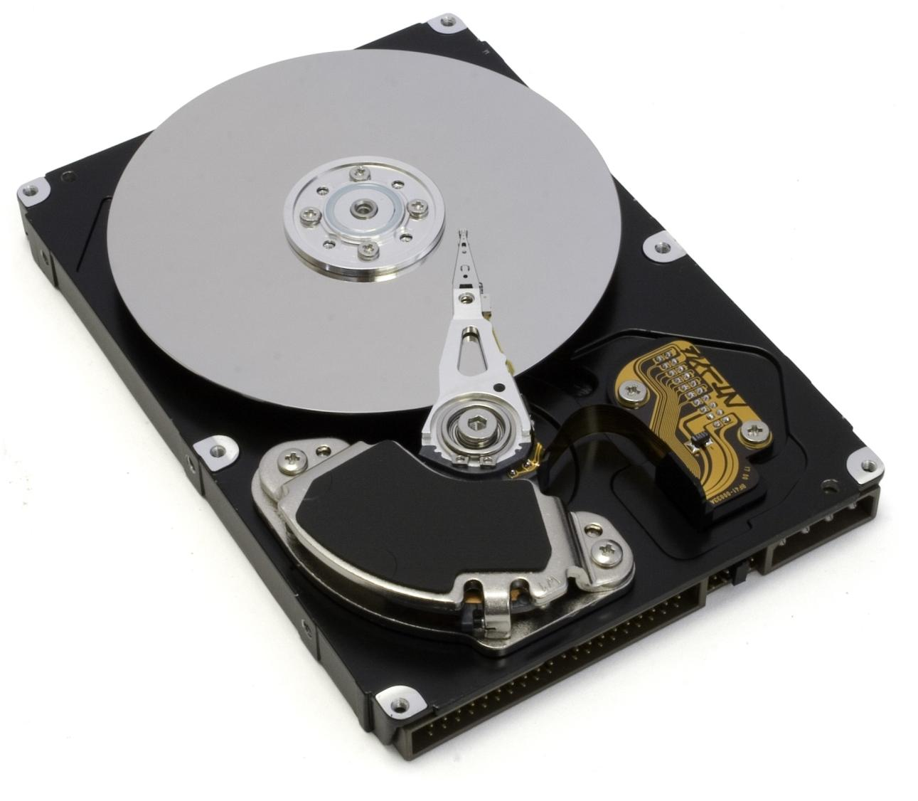

Slide 26
Specifying hardware
software
and
supplier

Slide 27
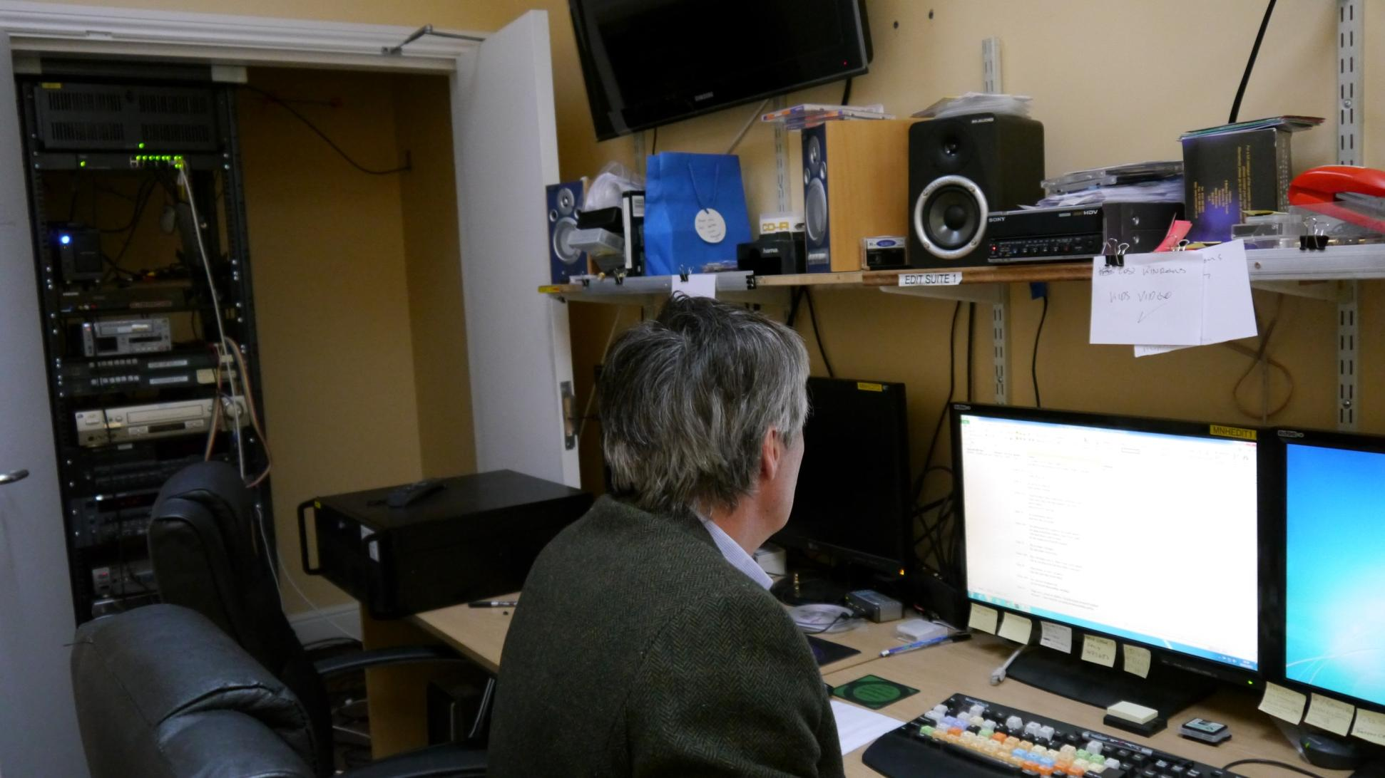
What we got
And
Scalability

Slide 29
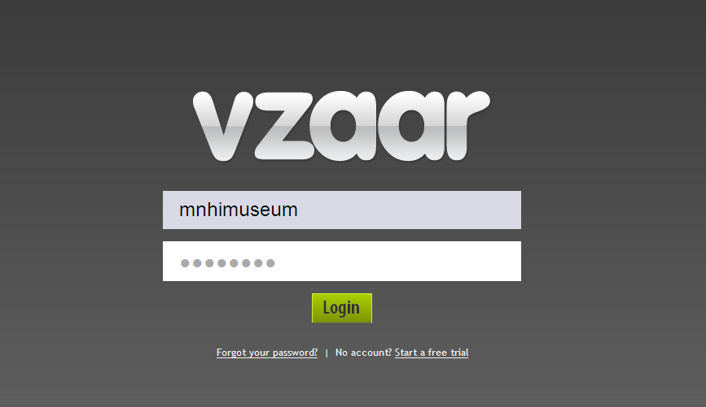

Slide 30
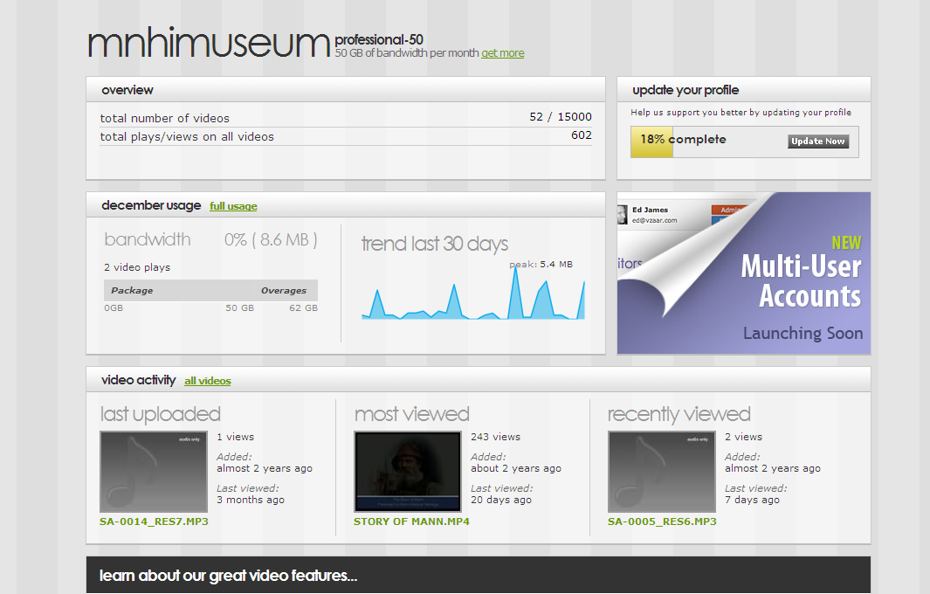

Slide 31
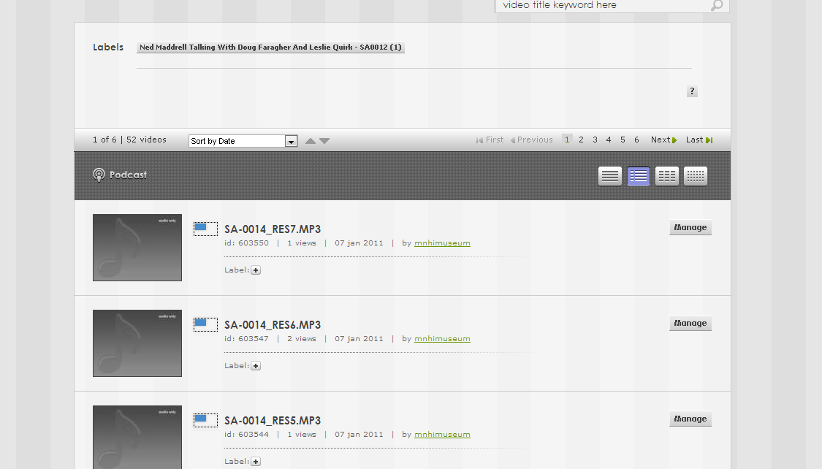

Slide 32
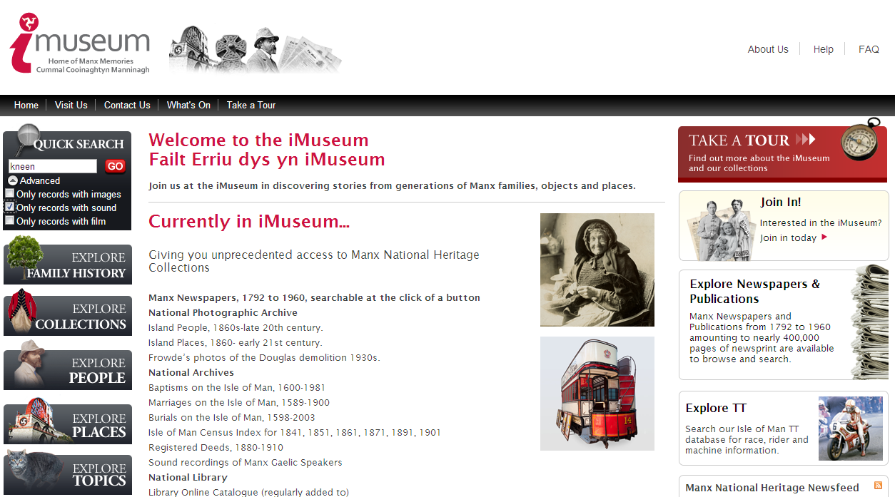

Slide 33
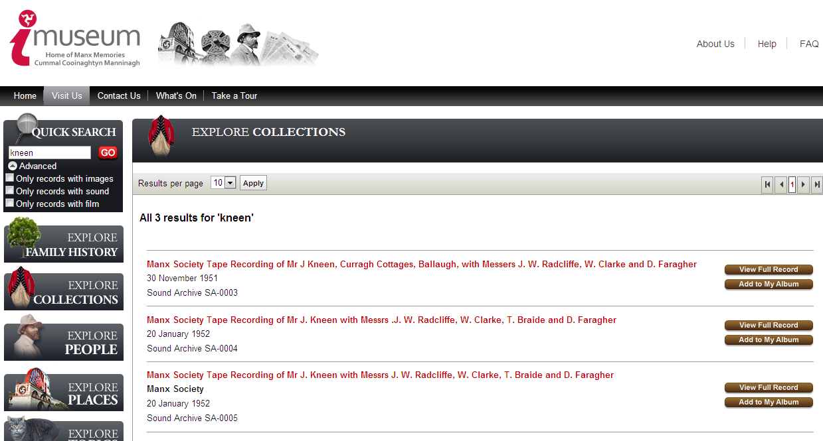

Slide 34
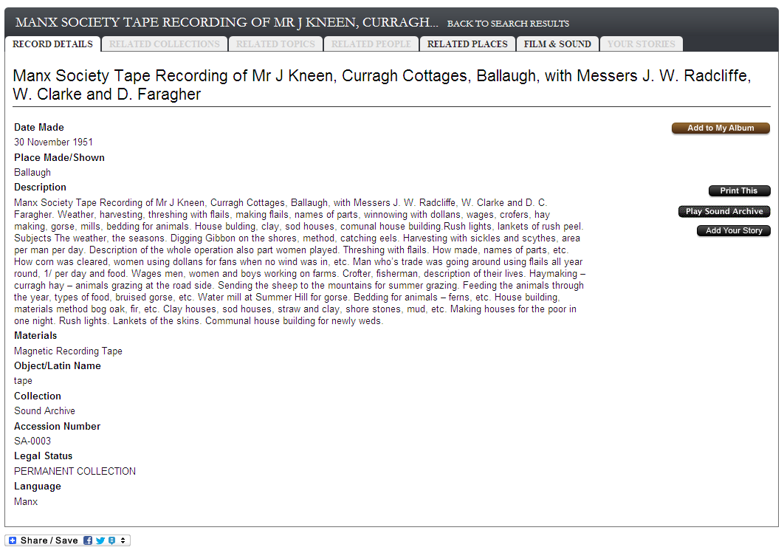

Slide 35
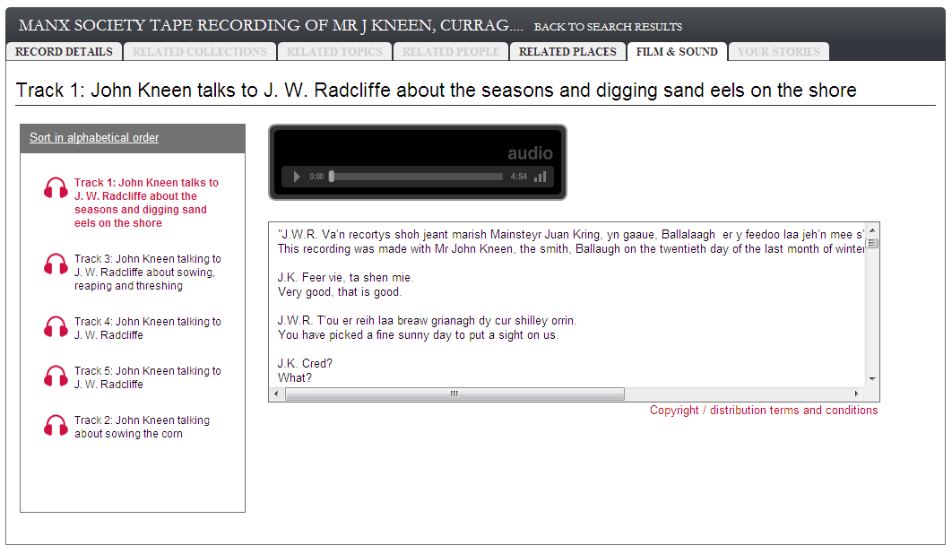


Slide 36
Where Next?
Add more Manx Gaelic recordings
Have more past recordings digitised
Current Oral History recordings in digital format

