Slide 1

BISA 2013
Metadata standards, tools and processes for audio preservation at the British Library:
An overview of new systems for audio description, preservation and access.
Adam Tovell
17th May 2013

Slide 2
BISA 2013:
Sound & Vision structure
CURATORIAL TEAMS
Classical Music
Oral History
Natural Sounds
Drama & Literature
World & Traditional Music
Popular Music
Radio
ACCESSIONS
CATALOGUING
TECHNICAL SERVICES

Slide 3
BISA 2013:
Technical Services
TECHNICAL SERVICES
PRESERVATION
ACCESS
DIGITAL LIBRARY STORE (DLS)
ON-SITE (EXPLORE THE BL)
OFF-SITE (SOUNDS)

Slide 4
BISA 2013:
Departmental structure
CURATORS
ACCESSIONS
CATALOGUING
TECHNICAL SERVICES
DEVELOPMENT
ARCHITECTURE
DIGITAL PRESERVATION

Slide 5
BISA 2013:
Requirements for preservation vs. access
PRESERVATION
Robust
Technical metadata
Provenance metadata
File validation
Secure
File verification
Redundancy
Enduring
Accepted standards
Extensible metadata
Authentic
Retains context
ACCESS
Instant
Streaming media
Integrated
Discoverable alongside non-AV
Aligned with other BL resources
Rich
Navigable
Related media
Authentic
Retains context

Slide 6
BISA 2013:
Requirements for preservation vs. access
PRESERVATION
Robust
Technical metadata
Provenance metadata
File validation
Secure
File verification
Redundancy
Enduring
Accepted standards
Extensible metadata
Authentic
Retains context
METADATA (METS) / PERSISTENT IDENTIFIERS (ARKs)
ACCESS
Instant
Streaming media
Integrated
Discoverable alongside non-AV
Aligned with other BL resources
Rich
Navigable
Related media
Authentic
Retains context

Slide 7
BISA 2013:
METS and ARKs
Metadata Encoding and Transmission Standard (METS)
‘The METS schema provides a flexible mechanism for encoding descriptive, administrative, and structural metadata for a digital library object, and for expressing the complex links between these various forms of metadata’.
‘It can therefore provide a useful standard for the exchange of digital library objects between repositories. In addition, METS provides the ability to associate a digital object with behaviours or services’.
Archive Resource Keys (ARKs)
Unique (per institution), persistent identifiers, enabling the granular linking of digital resources and forming an underlying infrastructure for delivering digital content.
ark:/81055/dvdc_100000100671.0x000003

Slide 8
BISA 2013:
METS structure
METS XML
DESCRIPTIVE METADATA
ADMINISTRATIVE METADATA
FILE SECTION
STRUCTURAL MAP
STRUCTURAL LINK

Slide 9
BISA 2013:
METS: Descriptive metadata
DESCRIPTIVE METADATA
Points to Sound and Moving Image catalogue records
Contains basic descriptive labels for navigable parts
<mets:dmdSec ID=“dmd01">
<mets:mdRef MDTYPE="MARC" xlink:href="ark:/81055/dvdc_100000100671.0x000003" LOCTYPE="ARK" />
</mets:dmdSec>
<mets:dmdSec ID=“dmd02">
<mets:mdRef MDTYPE="MARC" xlink:href="ark:/81055/dvdc_100000100671.0x000002" LOCTYPE="ARK" />
</mets:dmdSec>
<mets:dmdSec ID="dmd-4">
<mets:mdWrap MDTYPE="MODS">
<mets:xmlData>
<mods:mods>
<mods:titleInfo>
<mods:partName>Act 1, scene 1</mods:partName>
</mods:titleInfo>
</mods:mods>
</mets:xmlData>
</mets:mdWrap>
</mets:dmdSec>

Slide 10
BISA 2013:
METS: Administrative metadata
ADMINISTRATIVE METADATA
Contains technical metadata about ingested files
Contains provenance metadata about ingested audio-visual files
Uses PREMIS data alongside new XML schemas: mediaMD and processMD
mediaMD
Records the technical characteristics of a media file
Uses information generated by Mediainfo (http://mediainfo.sourceforge.net/en)
processMD
Records the equipment, settings and processes involved in creating a media file
Manually entered during migration

Slide 11
BISA 2013:
METS: Administrative metadata
<mediaMD:mediaMD>
<mediaMD:fileData>
<mediaMD:filename>026A-C1193X0001XX-ZZZZM0.wav</mediaMD:filename>
<mediaMD:format>Wave</mediaMD:format>
<mediaMD:mimetype>audio/vnd.wave</mediaMD:mimetype>
<mediaMD:fileSize>3407464138</mediaMD:fileSize>
<mediaMD:duration>01:38:35.284</mediaMD:duration>
<mediaMD:creationDate>2012-11-20T11:37:33Z</mediaMD:creationDate>
</mediaMD:fileData>
<mediaMD:stream type="audio" ID="str-1">
<mediaMD:format>PCM</mediaMD:format>
<mediaMD:commericalFormat>PCM</mediaMD:commericalFormat>
<mediaMD:formatSettings>
<mediaMD:formatSettingsEndianness>Little</mediaMD:formatSettingsEndianness>
</mediaMD:formatSettings>
<mediaMD:duration>01:38:35.284</mediaMD:duration>
<mediaMD:bitRate mode="constant" units="bps">4608000</mediaMD:bitRate>
<mediaMD:frameRate units="fps">25.000</mediaMD:frameRate>
<mediaMD:samplingRate>96000</mediaMD:samplingRate>
<mediaMD:bitDepth>24</mediaMD:bitDepth>
<mediaMD:channels>2</mediaMD:channels>
<mediaMD:timecodeIn>00:00:00.000</mediaMD:timecodeIn>
<mediaMD:streamSize>3407204130</mediaMD:streamSize>
</mediaMD:stream>
</mediaMD:mediaMD>

Slide 12
BISA 2013:
METS: Administrative metadata
<processMD:processMD>
<processMD:process ID="proc-0" type="transfer">
<processMD:processDate>2013-05-13</processMD:processDate>
<processMD:worker name="Adam" last="Tovell" organisation="The British Library" />
<processMD:deviceChain>
<processMD:device ID="dev-0" type="hardware" subType="tape recorder" role="reproducer">
<processMD:manufacturer>Studer</processMD:manufacturer>
<processMD:model>A807</processMD:model>
<processMD:serial>123456</processMD:serial>
<processMD:output type="audio" channels="2" level="line">
<processMD:format>analogue balanced</processMD:format>
</processMD:output>
<processMD:settings>
<processMD:speed mode="fixed" units="centimeters per second">19</processMD:speed>
<processMD:equalisation>CCIR</processMD:equalisation>
</processMD:settings>
</processMD:device>
<processMD:device ID="dev-1" type="hardware" subType="ADC" role="convertor">
<processMD:clockSource IDREF="dev-1" />
<processMD:manufacturer>Prism Sound</processMD:manufacturer>
<processMD:model>Dream ADA-8XR</processMD:model>
<processMD:serial>123456</processMD:serial>
<processMD:input type="audio" channels="2" level="line">
<processMD:format>analogue balanced</processMD:format>
</processMD:input>
<processMD:output type="data">
<processMD:format>IEEE 1394b</processMD:format>
</processMD:output>
</processMD:device>

Slide 13
BISA 2013:
METS: Administrative metadata
<processMD:device ID="dev-2" type="hardware" role="PC">
<processMD:manufacturer>Bespoke</processMD:manufacturer>
<processMD:input type="data">
<processMD:format>IEEE 1394b</processMD:format>
</processMD:input>
<processMD:component ID="comp-0" type="software" role="OS">
<processMD:manufacturer>Microsoft</processMD:manufacturer>
<processMD:model>Windows 7 Enterprise</processMD:model>
<processMD:version>64-bit</processMD:version>
</processMD:component>
<processMD:component ID="comp-1" type="software" subType="digital audio editor" role="application">
<processMD:manufacturer>Steinberg</processMD:manufacturer>
<processMD:model>Wavelab</processMD:model>
<processMD:version>7.2.1</processMD:version>
</processMD:component>
</processMD:device>
</processMD:deviceChain>
</processMD:process>
</processMD:processMD>
</mets:xmlData>
</mets:mdWrap>
</mets:digiprovMD>

Slide 14
BISA 2013:
METS: File section
FILE SECTION
Lists files contained in a single ‘package’
Details their uses (audio, video, image, transcripts, master and access) and locations

Slide 15
BISA 2013:
METS: File section
FILE SECTION
<mets:fileSec>
<mets:fileGrp USE="MasterManifestation">
<mets:fileGrp USE="Audio">
<mets:file ID="file-1" ADMID="amd-1"
CHECKSUM="3e545459b5152b04eb09f5a070b6fcc96a2902ce9afc5974fe435ea4a67d260c"
CHECKSUMTYPE="SHA-256" MIMETYPE="audio/vnd.wave" SIZE="3407464138">
<mets:FLocat LOCTYPE="ARK" xlink:href="ark:/81055/dvdc_100000100673.0x000003"/>
</mets:file>
</mets:fileGrp>
</mets:fileGrp>
<mets:fileGrp USE="AccessManifestation">
<mets:fileGrp USE="Audio">
<mets:file ID="file-2" ADMID="amd-2"
CHECKSUM="4ed6cbe7e1d794774443a40a6c58cd03e636694128cee25fa24438468912d528"
CHECKSUMTYPE="SHA-256" MIMETYPE="audio/mp4" SIZE="123426708">
<mets:FLocat LOCTYPE="ARK" xlink:href="ark:/81055/dvdc_100000100673.0x000003"/>
</mets:file>
</mets:fileGrp>
</mets:fileGrp>
<mets:fileGrp USE="Supplementary">
<mets:fileGrp USE="Image">
<mets:file ID="file-3" ADMID="amd-3"
CHECKSUM="0127a70f5fc1b969ac594cbeb3469f694240f0357bb2dfcdea9432f99d35ace7"
CHECKSUMTYPE="SHA-256" MIMETYPE="image/jp2" SIZE="23573619">
<mets:FLocat LOCTYPE="ARK" xlink:href="ark:/81055/dvdc_100000109305.0x000001"/>
</mets:file>
</mets:fileGrp>
</mets:fileGrp>
</mets:fileSec>

Slide 16
BISA 2013:
METS: File section

Slide 17
BISA 2013:
METS: Structural map
STRUCTURAL MAP
Defines order in which recordings appear, the files (or sections of files) that represent them, and links to the metadata that describe them
<mets:structMap TYPE="LOGICAL">
<mets:div ID="LOG0001" TYPE="Recording" DMDID="MODS0002" CONTENTIDS="ark:/81055/dvdc_100000400096.0x000001">
<mets:fptr>
<mets:area FILEID="FILE0001" BETYPE="SMPTE-25" BEGIN="00:52:28:15" END="01:38:30:23" />
</mets:fptr>
<mets:fptr>
<mets:area FILEID="FILE0002" BETYPE="SMPTE-25" BEGIN="00:52:28:15" END="01:38:30:23" />
</mets:fptr>
</mets:div>
</mets:structMap>
<mets:structMap TYPE="PHYSICAL">
<mets:div ID="PHYS0001" DMDID="MODS0001" TYPE="audioTape" CONTENTIDS="ark:/81055/dvdc_100000400099.0x000001">
<mets:fptr FILEID="FILE0001" />
<mets:fptr FILEID="FILE0002" />
</mets:div>
</mets:structMap>

Slide 18
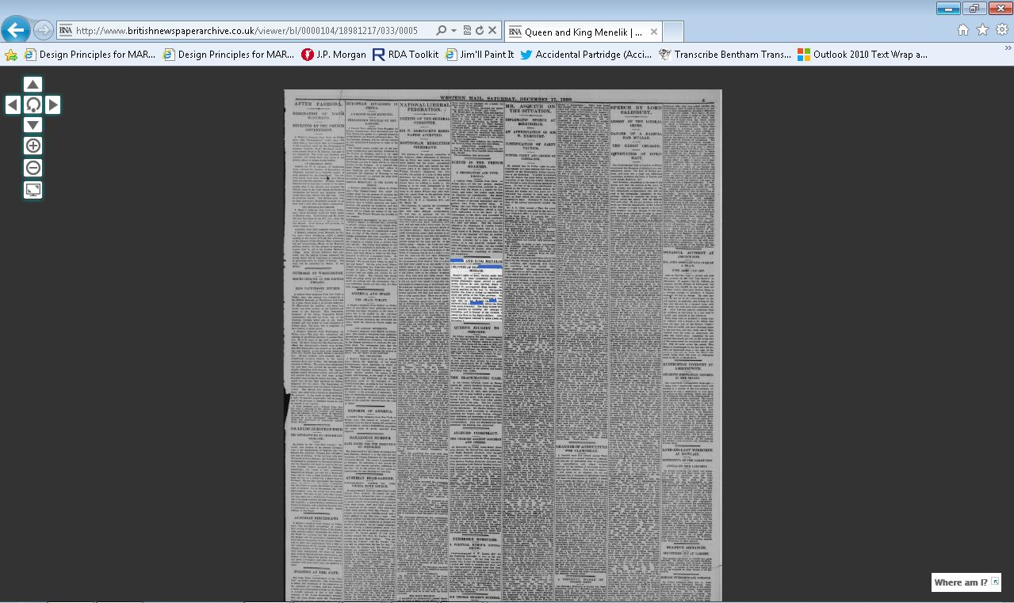
BISA 2013:
Page-level display

Slide 19
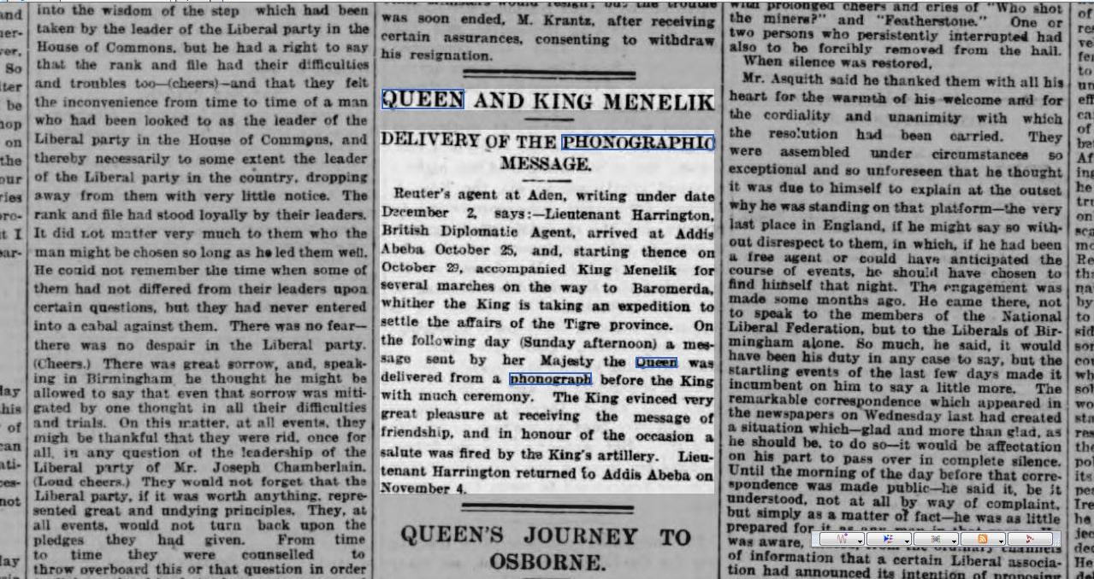
BISA 2013:
Article-level display

Slide 20
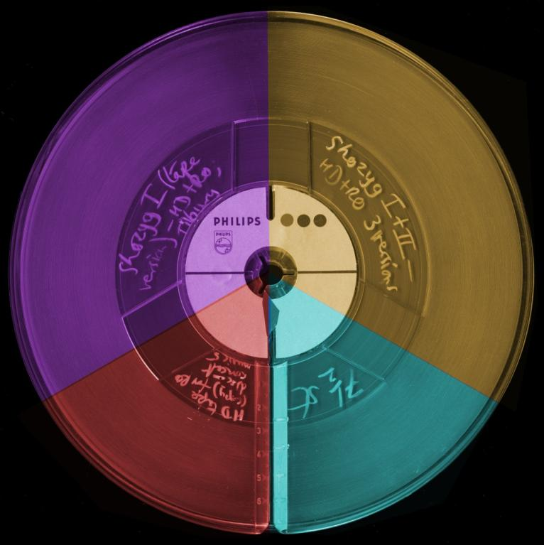
BISA 2013:
METS structure: recordings and parts
RECORDING 1
RECORDING 2
RECORDING 3
RECORDING 4
PART 1
PART 2

Slide 21
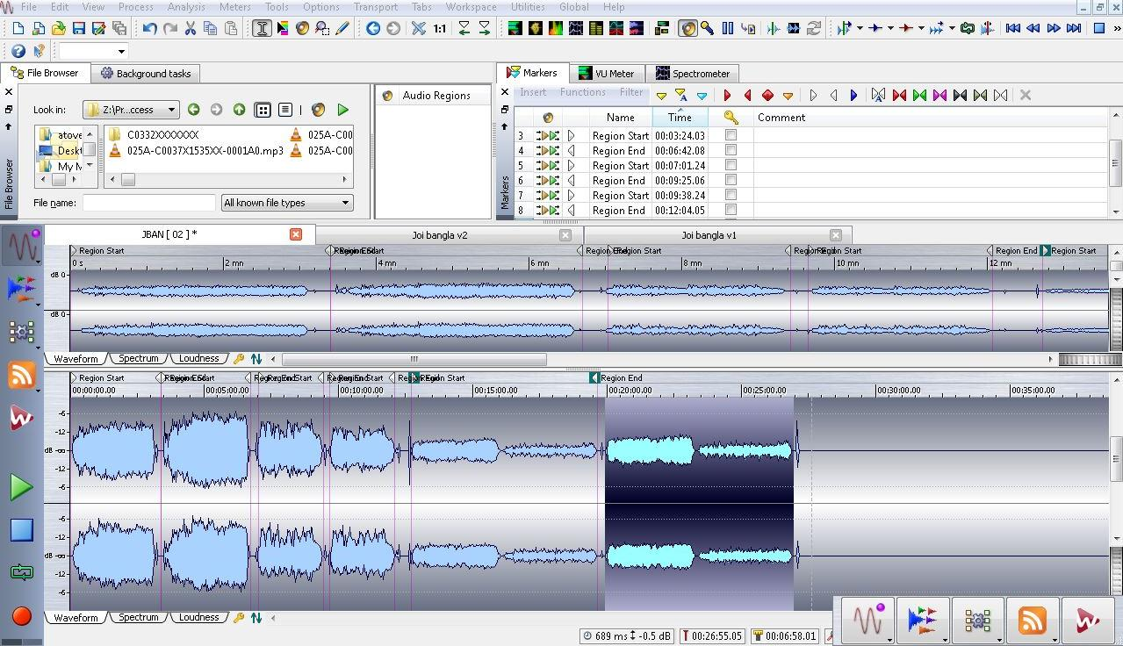
BISA 2013:
Wavelab region editing
METS XML

Slide 22
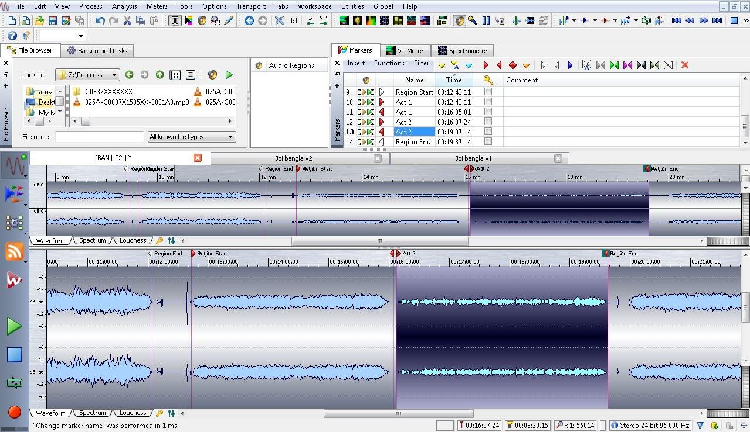
BISA 2013:
Wavelab region editing
METS XML

Slide 23
BISA 2013:
METS: Structural map
STRUCTURAL LINK
Establishes a hierarchical structure for the digital object, and records the relationships between all elements in the METS file.
<mets:structLink>
<mets:smLinkGrp>
<mets:smLocatorLink xlink:href="#PHYS0001" xlink:label="PHYSENTITY0001" xlink:type="locator" />
<mets:smLocatorLink xlink:href="#LOG0001" xlink:label="LOGENTITY0001" xlink:type="locator" />
<mets:smArcLink xlink:type="arc" xlink:from="LOGENTITY0001" xlink:to="PHYSENTITY0001" ARCTYPE="logicalphysical" />
</mets:smLinkGrp>
<mets:smLinkGrp>
<mets:smLocatorLink xlink:href="#PHYS0001" xlink:label="PHYSENTITY0001" xlink:type="locator" />
<mets:smLocatorLink xlink:href="#LOG0002" xlink:label="LOGENTITY0002" xlink:type="locator" />
<mets:smArcLink xlink:type="arc" xlink:from="LOGENTITY0002" xlink:to="PHYSENTITY0001" ARCTYPE="logicalphysical" />
</mets:smLinkGrp>
</mets:structLink>

Slide 24
BISA 2013:
Workflows
RETRIEVE ITEM
INSPECT, CLEAN PREPARE
TRANSFER
MANUAL
SUBMIT FOR INGEST
QA
BUILD SUBMISSION
VALIDATE FILES
ENCODE ACCESS COPY
CREATE CHECKSUMS
AUTOMATED
INGEST AND PUBLISH
WRITE METS
CHARACTERISE FILES

Slide 25
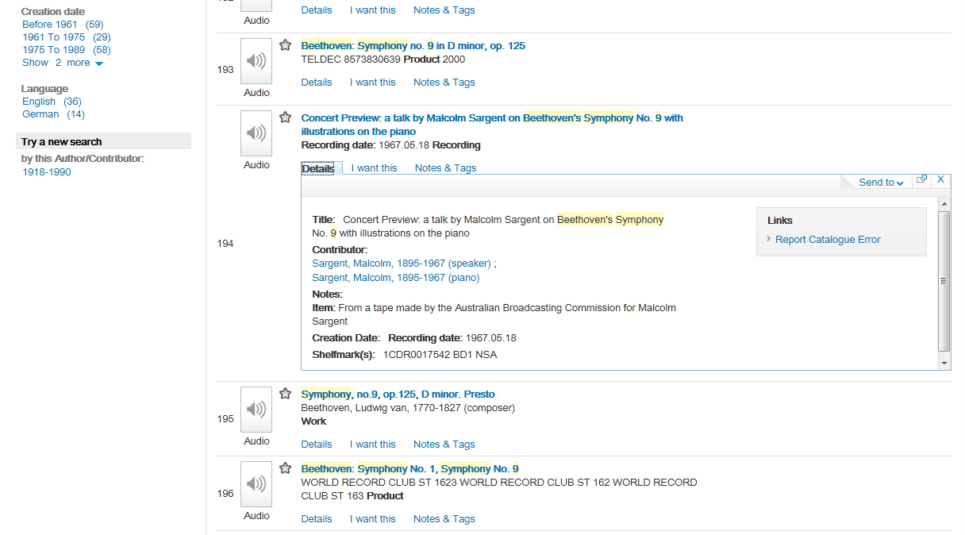
BISA 2013:
Catalogue search

Slide 26
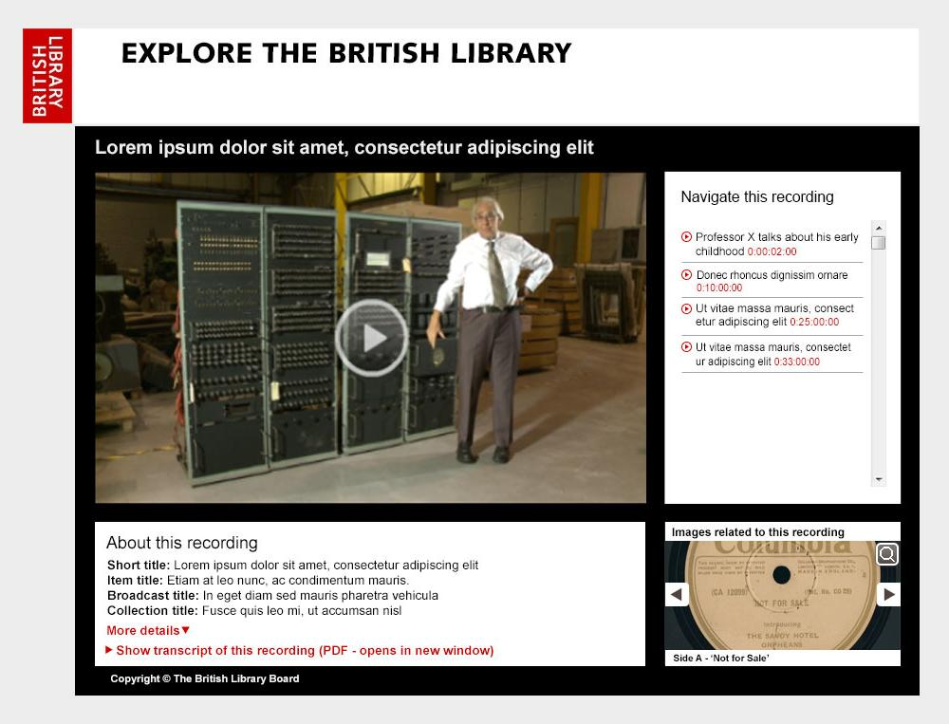
BISA 2013:
Sound & Moving Image Player

Slide 27
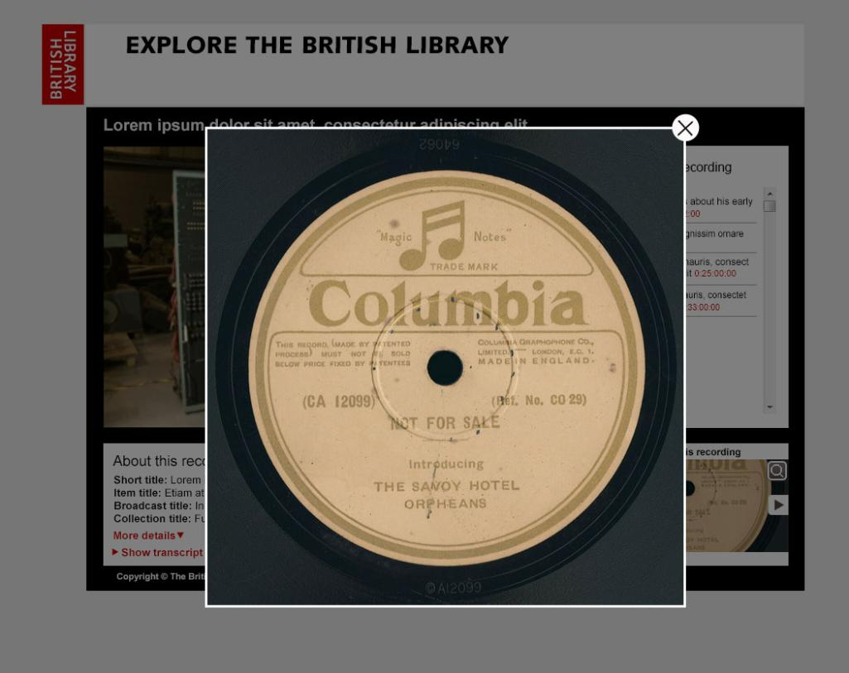
BISA 2013:
Sound & Moving Image Player

Slide 28
BISA 2013:
Sound & Moving Image Player
TITLE
PLAYER
NAVIGATION
ASSOCIATED IMAGES
DESCRIPTIVE METADATA (IMAGES)
DESCRIPTIVE METADATA
LINK TO TRANSCRIPT

